Slide 1
Deep Hashing for Compact Binary Codes Learning
Venice Erin Liong, Jiwen Lu , Gang Wang, Pierre Moulin, Jie Zhou
CVPR2015

Slide 2
Outline
Introduction
Related Work
Proposed Approach
Results
Conclusion

Slide 3
Introduction
a low-dimensional representation or equivalently a short code consisting of a sequence of bits.
Data-independent：LSH；kernelized/discriminative extensions……
random projections + binarization
Data-dependent: SH, BRE, ITQ，KMH, MLH……
statistical learning techniques
the nonlinear manifold structure of samples.
the scalability problem.

Slide 4
Learning-based Hashing
unsupervised：label information of the training set is not required
ITQ……
semi-supervised ： the pairwise label information is used &
SSH、BRE、MLH……
supervised：the pairwise label information is used
LDA……
Weakness： seek a single linear projection, cannot well capture the nonlinear structure of samples.

Slide 5
Related Work——Deep Learning
Aim：learn hierarchical feature representations by building high-level features from raw data.
semantic hashing is the ﬁrst work on using deep learning techniques for hashing.

Slide 6
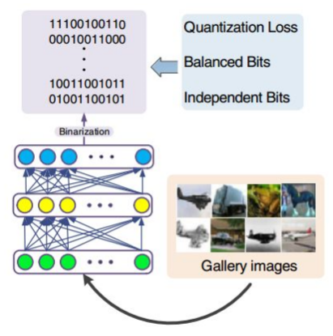
New Idea——DH

Slide 7
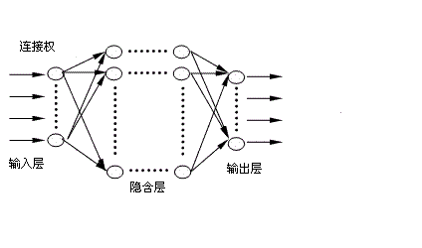
DH
全连接层
哈希编码层

Slide 8
DH——Output
1th layer:
2th layer:
mth layer:

Slide 9
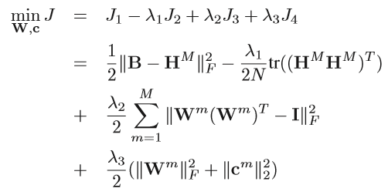
DH—— the parameters of our network
the quantization loss
the variance of learned
binary vectors
a relaxed orthogonality constraint
control the scales of the parameters

Slide 10
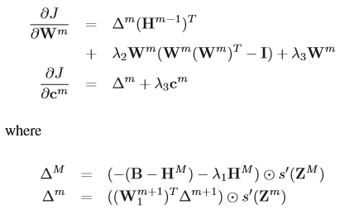
DH——stochastic gradient descent

Slide 11
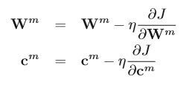
DH——update parameters
an unsupervised learning approach

Slide 12
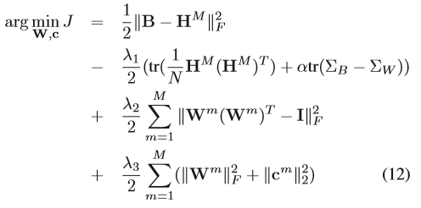
SDH——Supervised Deep Hashing

Slide 13
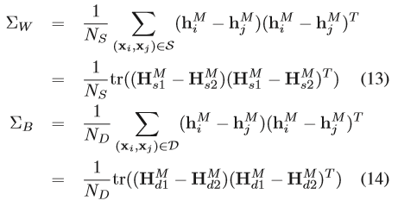
SDH
minimize the intra-class variations
maximize the inter-class variations

Slide 14
Experiment
Datasets：
CIFAR-10
MNIST
LabelMe22k

Slide 15
Settings
𝑀 =2,
[60 → 30 → 16], [80 → 50 → 32], and [100 → 80 → 64] .
the hyperbolic tangent function as the non-linear activation function .
The parameter 𝛼 for SDH was empirically set as 1.

Slide 16
Evaluation metrics
1) mAP: which computes the area under the precision-recall curve and evaluates the over all performance of different hashing algorithms;
2) precision@N: the percentage of true neighbors among top 𝑁 retrieved samples.
3) precision@r: the precision over all the points in the buckets that fall within a hamming radius of r=2 (a failed search would have zero precision).

Slide 17
CIFAR-10
60000 color images from 10 object classes
The size of each image is 32 × 32.
Query data： 1000 samples, 100 per class,
Gallery set： the remaining 59000 images.
Each image was represented as a 512-D GIST feature vector .

Slide 18
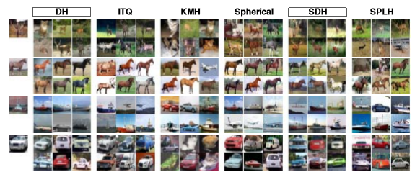
Results on CIFAR-10

Slide 19
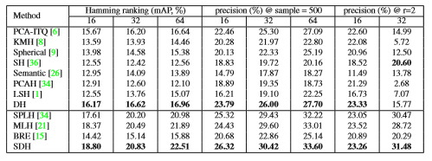
Results on CIFAR-10

Slide 20
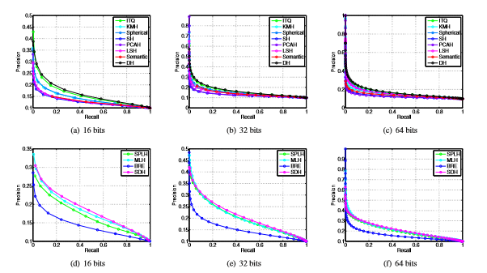
Results on CIFAR-10

Slide 21
MNIST
70000 handwritten digit images from 10 classes (labeled from 0 to 9).
The size of each image is 28 × 28.
Query data：1000 samples, 100 per class
Gallery set： the remaining 69000 images
Each image was represented as a 784-D gray-scale feature vector by using its intensity .

Slide 22
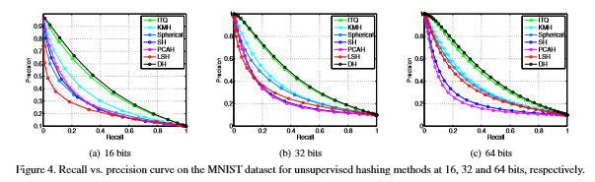
Results on MNIST

Slide 23
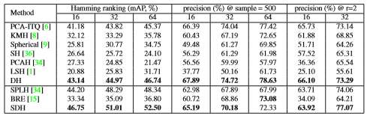
Results on MNIST

Slide 24
LabelMe22k
22000 object images
512-D GIST feature.
the ground truths ：a maximum of 50 semantic neighbors
Query data： 2000 images
the recall at the top 𝑁 ranked samples ： the fraction of retrieved true neighbors to the total number of true neighbors.

Slide 25
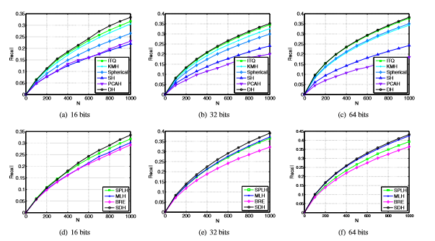
Results on LabelMe22k

Slide 26
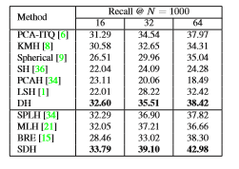
Results on LabelMe22k

Slide 27
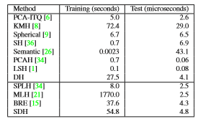
Computational Time
a 3.40GHz CPU
24.0 GB RAM.
CIFAR-10 dataset
16-bit binary codes

Slide 28
Conclusion
DH;SDH
effectiveness of the proposed methods
apply to other applications

Slide 29
Advantages & Cons
a strong nonlinear fitting ability, can be mapped to any complex nonlinear relationship,
when the data is not sufficient ，the neural network will not work.
Network Structure
new sample affect networks
the number of input features of each sample must be the same;

Slide 30
THANK YOU.

